Slide 1

HPE Private Cloud AI Release 1.6 TOI
Product Update and Overview
Aug 2025
Ed Holden, Product Management
Josh Bonomini, Product Management

Slide 2
Confidential Disclosure Agreement
The information contained in this presentation is considered Confidential Information of Hewlett Packard Enterprise (HPE) and is subject to the Confidentiality terms and conditions in your HPE vendor or partner agreement
This presentation may be shared with HPE Authorized Service Providers and Channel Partners in hard-copy or electronic format for their internal training purposes only
This presentation is NOT to be used as a ‘leave behind’ for HPE external customers
The information in the presentation may only be shared verbally with HPE external customers who are under CDA and should NOT be used for commercial purposes
Do not remove any classification labels, warnings or disclaimers on any slide or modify this presentation to change the classification level
Do not remove this slide from the presentation
HPE does not warrant or represent that it will introduce any product to which the information relates
The information contained herein is subject to change without notice
HPE makes no warranties regarding the accuracy of this information
The only warranties for HPE products and services are set forth in the express warranty statements accompanying such products and services
Nothing herein should be construed as constituting an additional warranty
HPE shall not be liable for technical or editorial errors or omissions contained herein
Strict adherence to the HPE Standards of Business Conduct regarding this classification level is critical

Slide 3

Introduction

Slide 4
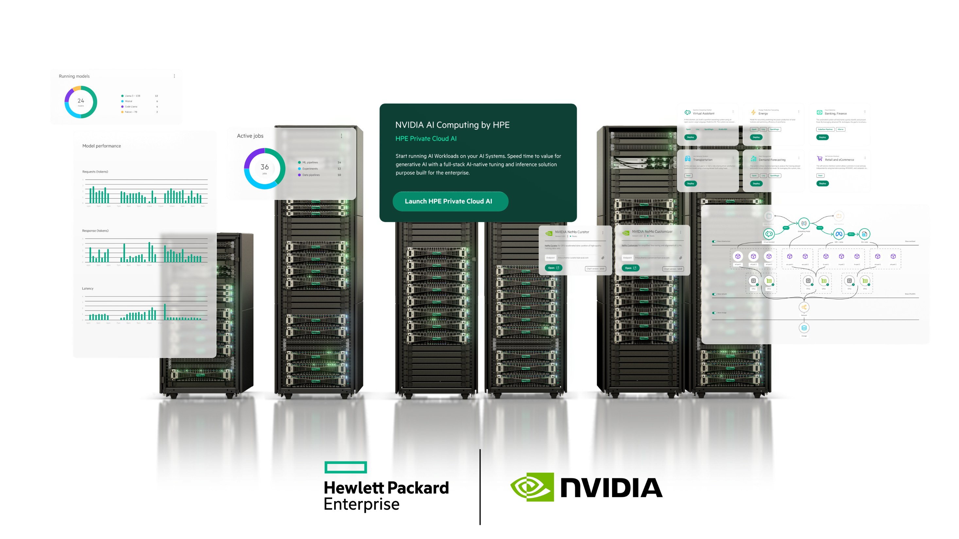
NVIDIA AI Computing by HPE
HPE Private Cloud AI
⁴
Notes:
Intent of Slide : Introducing HPE Private Cloud AI, the first turnkey AI solution that arrives ready to run with the hardware, software, and services you need to get instant AI productivity for your organization.

Slide 5


What’s New in PCAI - Release 1.6 Details
Full-stack, secure, private AI platform
Turn-Key AI Productivity
Next-Gen Compute Hardware | HPE ProLiant DL380a Gen12 based Worker Nodes
Latest NVIDIA GPUs | Support for NVIDIA H200 GPUs
“Timeless” Expansion Options | Grow your PCAI with Expansion Rack Options
Common Linux O/S | Worker nodes now using Ubuntu for better Life-Cycle Management support
AI skills
HPE Private Cloud AI
AI solutions
AI data
AI architecture
Fast time to value

Slide 6
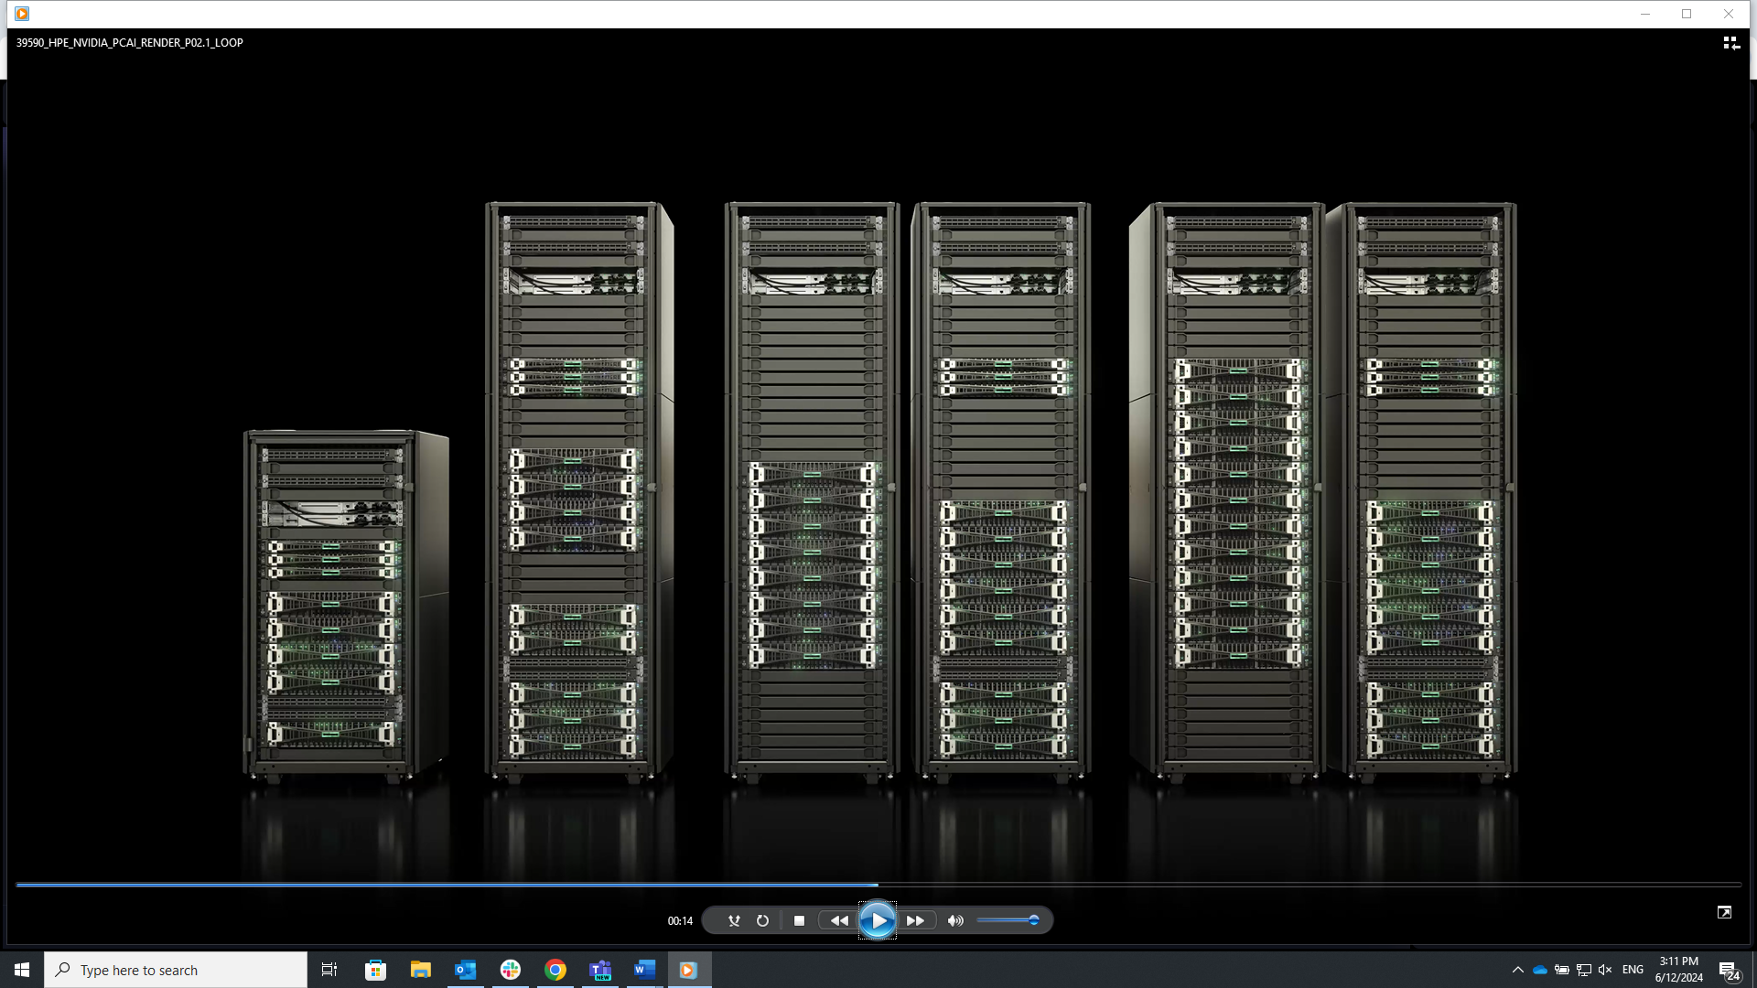
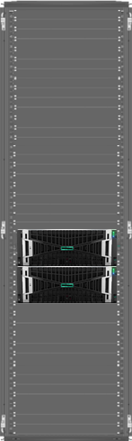
HPE Private Cloud AI G2 Family
AI optimized hardware with easy expansion options for investment protection
Inferencing | Inferencing + RAG | Inferencing + RAG + Fine-tuning | Inferencing + RAG + Fine-tuning + Training
Expansion Rack
Future
Future
Unified experience through HPE GreenLake cloud
Small
Medium
Large
Xtra Large
G2 Expansion Rack
Compute
Expansion
*Storage
Networking
Power
4 or 8x NVIDIA RTX Pro 6000 GPUs | 8x NVIDIA H200 GPUs | 16x NVIDIA H200 GPUs | 16x NVIDIA B300 GPUs
8-16x RTX Pro 6K or +16x H200 (1x Expansion Rack) | 24x H200 GPUs (1x Expansion Rack) | 64x H200 GPUs (3x Expansion Racks) | TBD GPUs (TBD Expansion Racks)
109 TB | 109 TB | 217 TB | 670 TB (TBD)
400GbE NVIDIA Networking | 400GbE NVIDIA Networking | 400GbE NVIDIA Networking | 800GbE NVIDIA Networking
Up to 12 kW | Up to 13 kW | Up to 17.4 kW | Up to 30kW x2
16x NVIDIA GPUs
N/A
N/A
400GbE NVIDIA Networking
Up to 12kW
Notes:
Intent of slide: Introduce the Scalable starting points.
Choice of scalable validated starting points: optimized for your use cases today and tomorrow, HPE will right size your infrastructure needs so you can start small and then scale up on proven configurations to address multiple use cases, higher throughputs, or more users with a modular, cloud-native architecture.
These are not configurations or reference architectures. These full stack AI solutions arrive pre integrated and ready to run.

Slide 7
HPE AI Essentials Software
The AI development platform
Models &
NVIDIA Blueprints
Pre-validated & production ready models
1-click model deployment
Catalog of preoptimized blueprints for GenAI apps
GPU optimized
AI software
Intuitive AI workflows,
no code experience
AI tools and data
self-service access
AI Software &
Data Foundation
AI-ready data pipelines and curations
Data Lakehouse: unified data access and centralized security
Composable and extensible
HPE Data Lakehouse Gateway
Unified and governed access
AI Platform
Foundations
Automated lifecycle management
Intelligent resource allocation
Observability and alerts
Zero-trust security
HPE GreenLake Cloud
Confidential - For Training Purposes Only
Notes:
Intent of this slide: HPE is ready to meet you where you are on your journey.
You can start anywhere:
As businesses look to the next wave of transformation, we can meet you at different starting points whether you aim to connect your edge, turn your data into intelligence with AI, create your hybrid cloud or secure your data..
You can Explore HPE GreenLake with an interactive demo experience, hosted trial or test drive or
You can engage with our experts for an advisory session and get started your hybrid cloud journey
THANK YOU

Slide 8
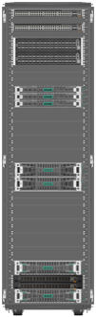

G2 Software Components (Small/Medium/Large)
Management experience​
HPE Private Cloud AI via HPE GreenLake cloud
Data Services Connector (DSC) VM
HPE AI Essentials
HPE VM Essentials and Kubernetes
OpsRamp Gateway
Control Nodes x3
AI Worker Nodes​
Ubuntu Linux
HPE AI Essentials with NVAIE
OpsRamp Enterprise for PCAI
File + Object Storage​
HPE Alletra MP File OS
GreenLake for File Application

Slide 9
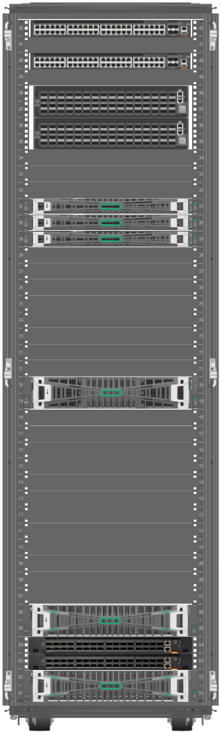
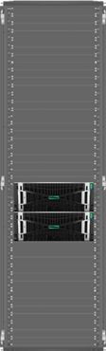
HPE Private Cloud AI G2 Medium Configuration
Medium G2 T-Shirt Size
Network Switches
2 x Nvidia SN4700M Switches (400GbE data network)
2 x Aruba 6300M ( Management & ILO)
Control Plane
3x DL325 Gen 11 Nodes
AI Worker Nodes
2x DL380a Gen 12 AI Optimized Node
4x NVIDIA H200 GPUs per server (8 total)
Storage
109TB GreenLake for File Storage
Based on Alletra MP
S3 Enabled
SW Licensing
HPE AI Essentials with Nvidia AI Enterprise Software
3/5 Year Subscription
Expansion Rack:
Medium Supports 1x Expansion Rack
Network is Cross Cabled to Base Rack
Add 16x H200 GPUs to base (24 GPUs Total)
Will be available with Next Gen GPUs in Future
AI Worker Nodes
2x DL380a Gen 12 AI Optimized Node
8x NVIDIA H200 GPUs per server (16 total)
Confidential | For Training Purposes Only

Slide 10
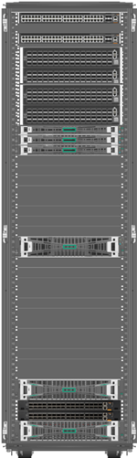
HPE Private Cloud AI G2 Large Configuration
Large G2 T-Shirt Size
Network Switches
4 x Nvidia SN4700M Switches (400GbE data network)
2 x Aruba 6300M ( Management & ILO)
Control Plane
3x DL325 Gen 11 Nodes
AI Worker Nodes
2x DL380a Gen 12 AI Optimized Node
8x NVIDIA H200 GPUs per server (16 total)
Storage
217TB GreenLake for File Storage
Based on Alletra MP
S3 Enabled
SW Licensing
HPE AI Essentials with Nvidia AI Enterprise Software
3/5 Year Subscription
Expansion Racks:
Large Supports 3x Expansion Racks
Network is Cross Cabled to Base Rack
Add 16 to 48 H200 GPUs to base (64 GPUs Total)
Will be available with Next Gen GPUs in Future
AI Worker Nodes
2x DL380a Gen 12 AI Optimized Node
8x NVIDIA H200 GPUs per server (16 total)
Confidential | For Training Purposes Only

Slide 11
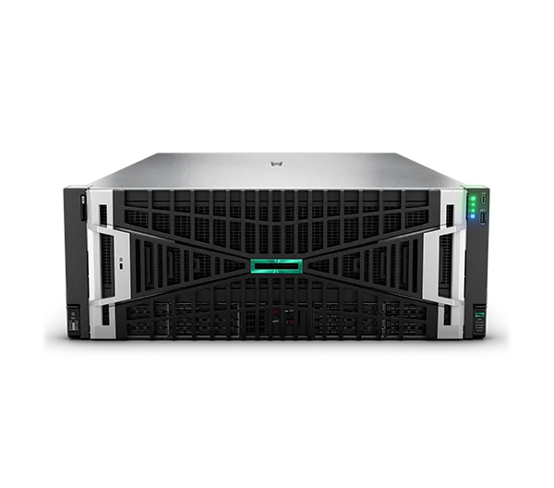
Worker Node Configuration Details
DL380a Gen12 for Medium
CPU: 2x Intel Xeon 6787P (86 cores)
Memory: 1536GB (16x 96GB)
Storage: NS204i (Boot) + 4x 3.2TB (Data)
Network: 2x 200Gb ports, 4x400Gb ports
GPU: 4x H200NVL
DL380a Gen12 for Large
CPU: 2x Intel Xeon 6787P (86 cores)
Memory: 3072GB (32x 96GB)
Storage: NS204i (Boot) + 4x 3.2TB (Data)
Network: 2x 200Gb ports, 4x400Gb ports
GPU: 8x H200NVL
Supply Chain Commonality Between Medium and Large Configs
Chassis: Same DL380a Gen12 CTO Sku across all T-shirt sizes
CPU: Same CPU across all T-shirt sizes
RAM: Same DIMM across Medium and Large (Only QTY differ)
NICs: Same NICs in Medium and Large
GPUs: Same GPU across Medium and Large (Only QTY differ)
Confidential - For Training Purposes Only

Slide 12
HPE Private Cloud AI Timeless Expansion Rack Strategy
PCAI Investment Protection
Base Rack
G2 Expansion Rack:
Expansion Rack Overview
  42U Rack with 2x AI Worker Nodes and PDUs
  Adds two worker nodes and 16x GPUs per Expansion Rack
  Connects to Top of Rack Switches in PCAI Base Rack
Customer Benefits
  Investment Protection- ability to add additional or future GPUs to current deployment
  Non-disruptive upgrade (G2 to G2+ Expansion)
  PCAI Cluster can be expanded to support additional nodes
  Modular upgrade with known power and footprint requirements
  No need to add additional network switches
Supported Upgrade Paths (P0 at purchase / P1 Post Install)
  Small G2 and Medium G2 to support 1x Expansion Rack (Up to 24x GPUs)
  Large G2 to support 3x Expansion Racks (up to 64x GPUs)
Future Upgrade Options (Not POR for 1.6)
  Expansion Rack with additional networking to support expansion above defined limits
  G1 to G2 Expansion Rack (Requires software update on G1 Base Rack)
Confidential - For Training Purposes Only

Slide 13
Comparison - PCAI G2 versus G1 Capabilities
Small
Medium
Large
Extra Large
Compute
Storage
Networking
Power
4 or 8 NVIDIA L40S GPUs | 8 or 16 NVIDIA L40S GPUs | 16 or 32 NVIDIA H100 NVL GPUs | Not Available in G1
109 TB | 217 TB | 670 TB
100GbE NVIDIA Networking | 200GbE NVIDIA Networking | 400GbE NVIDIA Networking
up to 8 kW rack | up to 17.7 kW | up to 25 kW x 2
G1
Compute
Expansion
Storage
Networking
Power
4 or 8x NVIDIA RTX Pro 6000 GPUs | 8 NVIDIA H200NVL GPUs | 16 NVIDIA H200NVL GPUs | 16 NVIDIA GPU (B300)
24x GPUs (1x Expansion Rack) | 24x GPUs (1x Expansion Rack) | 64x GPUs (3x Expansion Rack) | TBD GPUs (3x Expansion Rack)
109 TB file storage in rack | 109 TB file storage in rack | 217TB file storage in rack | Storage rack with 670 TB
400GbE NVIDIA Networking | 400GbE NVIDIA Networking | 400GbE NVIDIA Networking | 800GbE NVIDIA Networking
~12 kW per rack | 13 kW per rack | 17.4 kW per rack | 30 kW +per rack
G2
Future
Future
Benefits
1.7x more GPU Perf Video Codecs Support Expansion Rack Support | 1.7x more GPU Perf Lower storage costs Expansion Rack Support | 1.5x more GPU Perf Lower storage costs Expansion Rack Support | Top GPU performance Bigger NVLINK Domain Support Training Workloads
Notes:
Here is what we're delivering from a configuration perspective. We've announced four sized offerings and have the first three available now. Our objective is to create a baseline of GPU capabilities to enable a broad set of use cases within AI.
Our small config is designed to fit a broad set of data centers and has a basis set of storage integrated and straightforward networking. This includes all the software.
The medium configuration nearly doubles and is intended to deliver inferencing and RAG capabilities. RAG includes private data into the tuning of your AI systems so that you can take not only what's publicly available, but you can also put your own content in there.
The largest config now available is very robust and is a 2-rack system, and is used for inferencing, RAG, and fine-tuning.
This is a broad set of offerings, and we have tools that are available for customers to determine what type of workload/use cases they want to run. The tools will then guide them as to what configuration they need.

Slide 14
HPE Private Cloud AI G2 Family Comparison
Feature | G2 Medium | G2 Large | G2 Expansion Rack
Control Node Qty | 3 | 3 | 0
Worker Node QTY | 2 | 2 | 2
Worker Node Generation | HPE ProLiant Gen12 | HPE ProLiant Gen12 | HPE ProLiant Gen12
CPU Type / QTY (per node) | 2x Xeon 86 Core CPUs | 2x Xeon 86 Core CPUs | 2x Xeon 86 Core CPUs
GPU Type / QTY (per solution) | 8x H200 | 16x H200 | 16x H200
Expansion Racks Supported | 1 | 3 | N/A
Max GPU QTY (with expansion) | 24x H200 | 64x H200 | N/A
Storage | 109TB GreenLake for File with Object Storage | 217TB GreenLake for File with Object Storage | N/A
Networking Switches | 2x Nvidia 4700M 2x Aruba 6300M (oobm) | 4x Nvidia 4700M 2x Aruba 6300M (oobm) | N/A
NIC Speed (AI Network) | 400Gb NICs | 400Gb NICs | 400Gb NICs
Rack / PDU | 1x 42U Rack with PDUs | 1x 42U Rack with PDUs | 1x 42U Rack with PDUs
Install Services Included | Yes | Yes | Yes
Sales Motion | Traditional or GreenLake | Traditional or GreenLake | Traditional or GreenLake
Confidential | For Training Purposes Only

Slide 15
Prebuilt use cases & attached services help enterprises accelerate AI adoption
HPE is committed to building out use cases leveraging Solution Accelerators
… and HPE includes support and services to help customers at various stages in their AI adoption lifecycle
Automation
Task & workflow automation
Corporate AI governance processes
AI-driven event & incident management
AI skills
Virtual Assistants
Chatbots/Q&A
Code generation
Content summarization
AI data
Day -1 through Day 2 and beyond
Content and Product Creation
Sales & marketing
Internal communication & knowledge management
AI driven product dev & prototyping
AI
solutions
Financial Services
Public Sector
Retail
AI architecture
Telco
Healthcare
Life Sciences
Notes:
HPE Private Cloud AI is built for multiple horizontal use cases across several verticals.
The first use case is Virtual Assistants. This could mean chatbots, Q&A, code generation, and content summarization.
The second use case is Automation. Enterprises can use PCAI for task & workflow automation, corporate AI governance, and event & incident management.
The third use case is Content and Product Creation. Sales and marketings team can use AI for internal communication and knowledge management, as well as AI driven product development and prototype.
PCAI supports numerous verticals, and the horizontal use cases can be tuned based on the industry. For example, an enterprise in the retail industry would have a different use for a Chatbot than an enterprise in the Financial Services industry.
PCAI also includes support and services to help various stages in their AI adoption lifecycle, from Day -1 (consulting) to Day 0 (design), to Day 1 (implementation) through Day 2 and beyond (ongoing management and continuous improvement). Since each customer’s need is unique, HPE partners with a number of global systems integrators and software service delivery partners to help ensure those needs are fully met.

Slide 16

HPE AI Essentials Software Update

Slide 17
AI Essentials 1.10 Update and Value Proposition
H200 Support
Ubuntu Support
QoL Updates
New NVIDIA Network Operator
New NVIDIA GPU Operator
Ubuntu Linux Support on both AIE VMs and bare metal Control Plane and worker nodes​
Continued bug fixes and quality of life updates.

Slide 18
Country Enablement

Slide 19
HPE Private Cloud AI Country Roll Out
Country Enablement as of August 2025
GEO | Country
North America | US
 | Canada
NW Europe | Belgium
 | Denmark
 | Finland
 | France
 | Luxembourg
 | Netherlands
 | Norway
 | Sweden
UK | UK
UKIMEA | UAE
 | Saudi Arabia
 | Qatar
 | South Africa
 | Egypt
GEO | Country
Central Europe | Germany
 | Switzerland
 | Austria
 | Spain
 | Italy
 | Poland
 | Czech Republic
 | Turkey
 | Hungary
LASER | Portugal
 | Israel
 | Mexico
 | Columbia
 | Argentina
 | Chile
 | Peru
 | Puerto Rico
 | Greece
GEO | Country
APAC | Korea
 | Singapore
 | Thailand
 | Taiwan
 | Australia
 | India
 | Malaysia
 | Indonesia
 | Philippines
 | Vietnam
 | New Zealand
JAPAN | Japan
Notes:
Notes:
Initial 10 customer implementations will have BU Engineering White Glove Support Model
Deployment guide and delivery training is being updated with learnings and changes discovered through the first customer installs
Additional technical training targeted for January 2025
A&PS Implementation Services: Day 1 – Networking and Configuration Setup
Professional Services GCC
Owner: SXD Remote Professional Services (PN/Ashwin)
Installation & Startup Services: Day 1 – onsite install and startup
Owners: SXD Prof Svcs DPM (PN/Anand Chettri) and Global Support Field: Region Teams onsite
I &S Capability being rolled out – On Track, WBT and VILT availability through January’25.
Tech Care Essentials: Day 2 - OS reactive support service
Owners:
Support Calls: PCAI COE (Sanjay M/ Naveen/Vijay) – English only support. Local language requirements to be met on a country basis leveraging local resources for language translation.
Onsite field break/fix support: Global Support Field. As of 12/20/24, confirmation received from EMEA, -- awaiting APJ and AMS validation.

Slide 20
Technical and HPE Private Cloud AI Resources
Learn more about HPE Private Cloud AI
HPE Private Cloud AI developer system NVIDIA GTC announcement
Find additional resources in the HPE Private Cloud AI Briefcase.
Technical Training
HPE Private Cloud AI learning Path includes these and more training
  TekTalk on Point: Introducing NVIDIA AI Computing by HPE and the HPE Private Cloud AI.
  TekTalk: HPE Private Cloud AI Workload Sizing and Configurations.
  TekTalk: AI Essentials Foundations
  TekTalk: HPE Private Cloud AI Overview
NVIDIA Learning Paths
  AI Foundations (minor)
  AI Compute Foundations
  AI Technical Training

Slide 21

Q&A

Slide 22

Thank you

